Slide 1
Welcome to Revitalizing and Supporting Systems
Expectation will be to focus on implementation of consistent Tier 1 routines, behavior expectations, and system improvements
Office of Academics
August 1, 2025
Notes:
Mike intro
-No more Tier 1+
-AP/Dean Academic Director meetings
-Reorganization of MTSS Specialists and their role

Slide 2
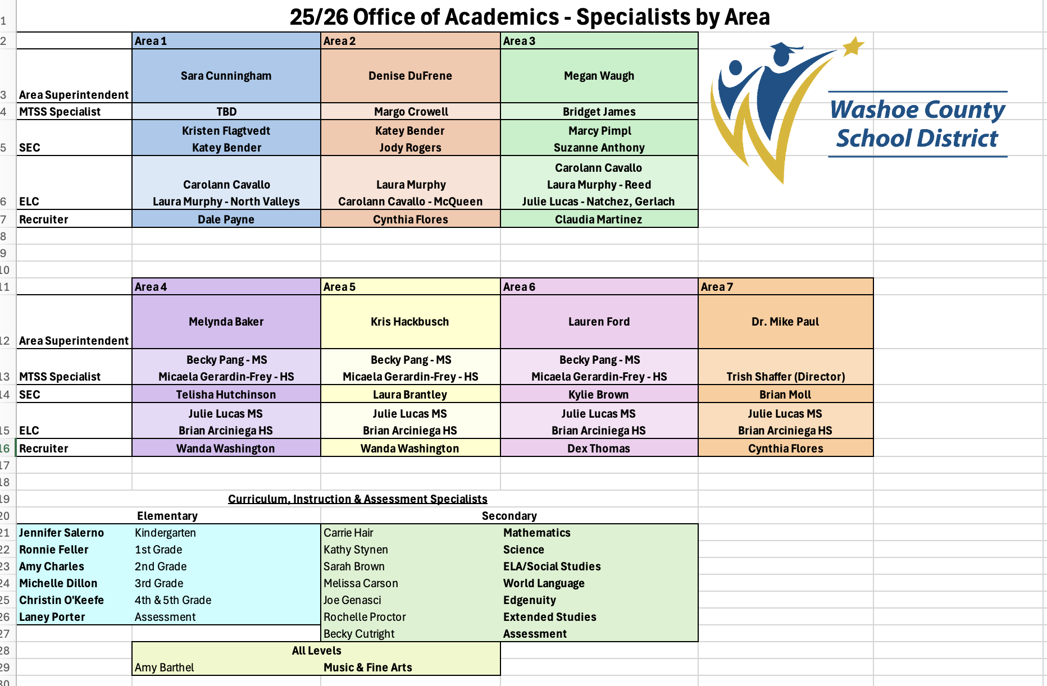
Notes:
Mike
This will be sent to you electronically

Slide 3
🎯 Learning Intentions
You’ll be introduced to Revitalizing and Supporting Systems, including key tools and resources, as they relate to your school to support reflection and planning.
✅ Success Criteria
Understand the goal and expectations of the Revitalizing and Supporting Systems work at Academy this year.
Describe and begin using the tools to assess current Tier 1 practices.
Identify next steps to bring this work back to my site.
💡 Relevance and Engagement
Strong Tier 1 systems are the foundation of effective MTSS. These tools help us reflect on what’s working, identify areas for improvement, and ensure consistency across classrooms and schools.
Notes:
Mike
1. Learning Intentions (What am I learning?)
These questions help students focus on the purpose of the lesson.
What are we learning today?
What is the big idea or concept behind this lesson?
How does this connect to what we’ve already learned?
Why is this learning important?
🎯 2. Success Criteria (How will I know I’ve learned it?)
These questions help students understand what success looks like.
What does a successful outcome look like for this task?
What should I be able to do or explain by the end of this lesson?
How will I know if I’ve done a good job?
What are the steps or skills I need to show?
🧠 3. Relevance and Engagement (Why am I learning this?)
These questions help students see the value and application of their learning.
How can I use this in real life?
Why is this important for my future learning or goals?
How does this relate to something I care about or am interested in?
What problems can I solve with this knowledge?

Slide 4
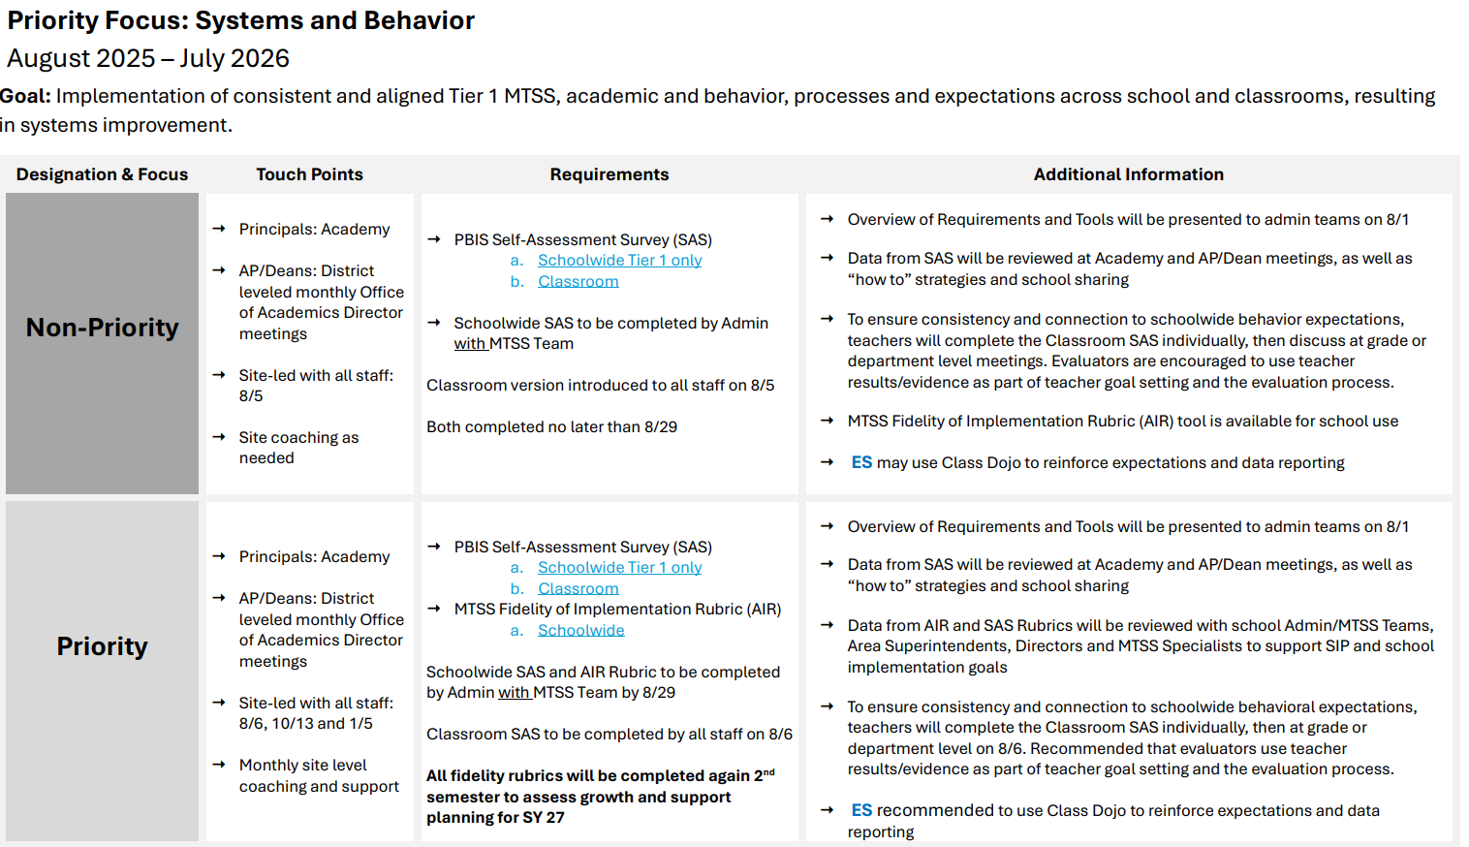
MTSS
PBIS
RTI
Notes:
Mike
Need a paper copies of this - 200
Snapshot of what principals can expect for the coming year with requirements and due dates.
A hard copy will be provided for each admin and will include the Priority+ level.
We will also provide a digital copy ahead of this presentation so that admin can use the links provided to review materials.
All documents and links needed for all of this – are available on the website. And our Priority schools have had them all emailed for the August 6th presentations.

Slide 5

Defining Multi-Tiered System of Supports
A systemic framework
(are we effective as a whole school?)
MTSS
Behavior
Academics
An individual needs framework
(what level of support
does each student need?)
PBIS
RTI
Notes:
Trish
For some historical context, mtss grew out of both RTI and PBIS. PBIS and RTI were being implemented in silo from each other, so MTSS is the combining and evolution of those two frameworks.
It creates a seamless system focused on matching students needs to a corresponding level of support that meets the needs of the whole child. It creates a problem solving culture in the school, and it’s both a systemic model to address the overall health and function of the school, as well as a model to address the needs of each student individually.
Grew out of parallel movements in education to address a variety of concerns
Creates a seamless system to address needs of the whole child
Creates a problem solving culture that is “information rich”

Slide 6
Screening
a systematic process for identifying students who may be at risk for poor learning outcomes
Multi-Level
Prevention System
the organization of supports for students that includes three tiers of increasing intensity for instruction and intervention
Progress Monitoring
the ongoing, frequent collection and use of formal data that was gathered with reliable and valid measures to make decisions
Data-Based Decision Making
use of data to make decisions about instruction, movement within and intensification of supports, and identification of students with disabilities
Infrastructure and Support Mechanisms
structures and logistics to support implementation of MTSS
Notes:
Tish
Briefly review the critical components of MTSS process…screen students, identify those who need support and match to that support. Progress monitor them and then make decisions based on the data
Acknowledge that everyone is at a different place – that is okay . Don't feel pressured that if you don’t have this running its bad. That’s bad. Its not, we are building foundations. Setting understanding of goals.

Slide 7
Provides a continuum of supports using data-based decision making
Tier 3: Intensive level of support
Provided to 3-5% of students
Students receive services at all levels, depending on need
Tier 2: Targeted level of support
Provided to 10-15% of students
Tier 1: Universal level of prevention
Provided to all students; goal to meet needs of at least 80% of students
Goal of MTSS is to match supports to “data-based needs of students”
(Graden, Stollar, & Poth, 2007, p.295)
Notes:
Trish
Systems and individual needs framework

Slide 8

MTSS addresses the needs of the whole child by aligning systems and supports.
Phonics, Fluency
Addresses needs of all students across the continuum
(e.g., no such as thing as a "Tier 2 kid" or "SPED student")
Reading Comprehension
Self-Regulation
Emotional Skills
Engagement
Math Calculation
Written Expression
Science
Social Skills
Attendance
Communication Skills
Credit: George Sugai
Notes:
Trish
It is important to note, MTSS addresses the need of the WHOLE child by aligning systems and supports that provides high-quality academic, social, emotional and behavioral programming and supports designed to meet the needs of all students at different levels.
In this system there is no such thing as a Tier 2 or SPED kids. Instead, each student’s individual needs are assessed and responded to with the appropriate level of supports. Just because a student needs targeted intervention for reading comprehension (academic), they may not need that level of support for math (also academic), but they may also need more targeted supports in communication skills but has excellent self-regulation skills. No student fits neatly in a single tier!

Slide 9
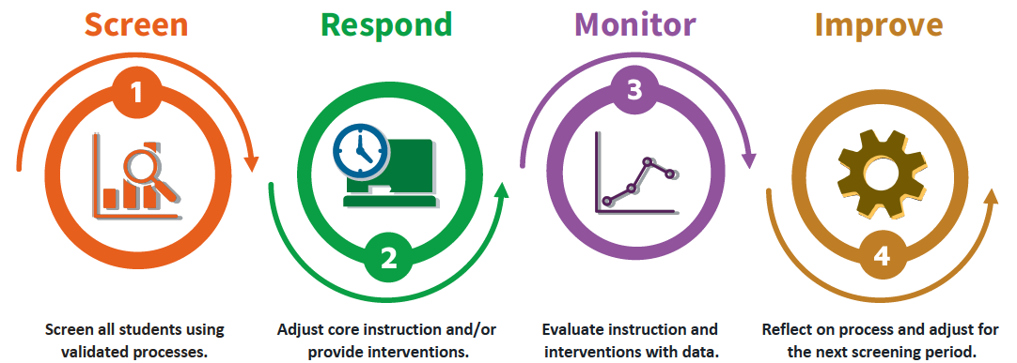
Build a system so schools can:
https://mtss4success.org/resource/mtss-snapshot
Notes:
Trish
We try to simplify things and make it practical. Basically, each benchmark period, we wants schools to do these 4 things (Describe them)
Reiterate that this is for academics and behavior

Slide 10
PBIS Self-Assessment of Systems
Focus Areas:
  Schoolwide systems – Admin with MTSS team
  Classroom practices – Teachers
Why it matters:
  Informs action planning
  Promotes staff voice and shared ownership
  Supports continuous improvement of Tier 1 systems
When to use:
  Annually or biannually
  As part of MTSS reflection and planning
Notes:
Lindsay
(SAS)
What it is:
A staff-completed survey that assesses the implementation status of schoolwide PBIS systems.
Purpose:
To identify strengths and areas for growth in your school’s behavior support systems.

Slide 11
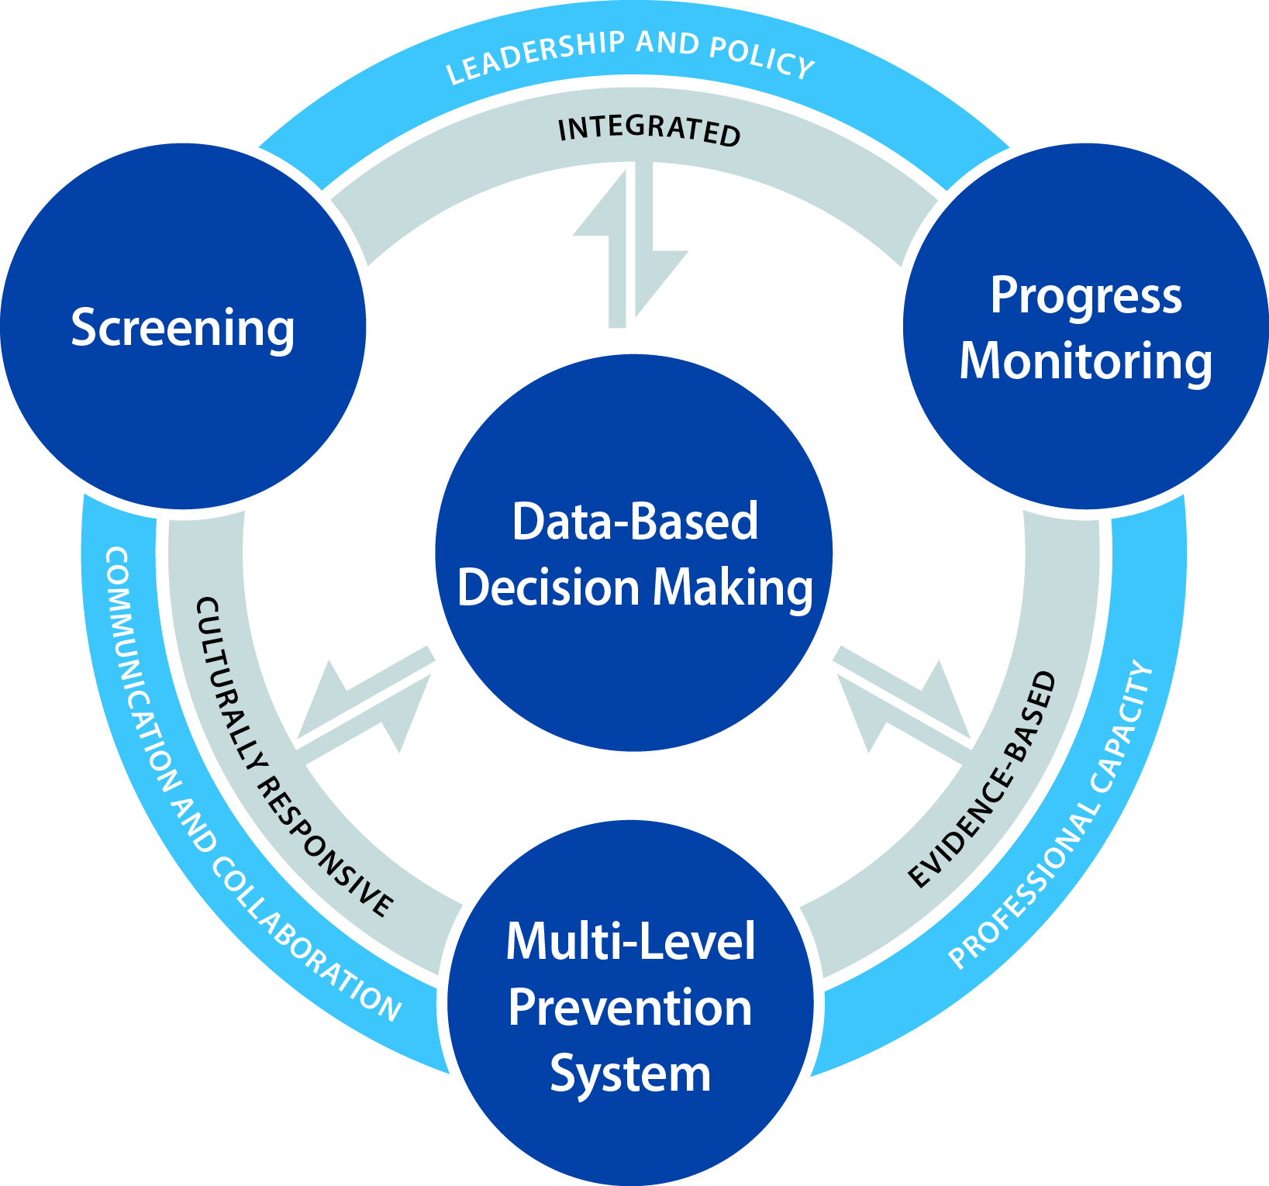
AIR MTSS Fidelity of Implementation Rubric
Primarily Academic Focus
Fidelity is the degree to which a practice is implemented as intended.
The Rubric is used to assess implementation of MTSS and the results can provide a roadmap for implementation.
  Universal Screening
  Progress Monitoring
  Multi-Level Prevention System
  Data-Based Decision Making
  Infrastructure
Notes:
Lindsay
What is the AIR Fidellity Rubric? It’s our measure of implementation of MTSS
Schools will be provided an digital copy of the AIR Rubric and a link to the FORM for completion (QR Code) we will give schools an overview of the tool, provide details directions for completion. They will have a one-page handout with all the directions and due-dates

Slide 12


Collaboration Time
PBIS Schoolwide Self-Assessment of Systems
AIR MTSS Fidelity of Implementation Rubric
Notes:
Lindsay
For remainder of session, participants will have time to ask questions of staff and begin to review/complete fidelity rubric tools

Slide 13

Survey for FINAL round of the day only.

